Slide 1


HR Insights
Last data refresh:
27/03/2023 17:55:38 UTC
Downloaded at:
27/03/2023 18:52:34 UTC

Slide 2
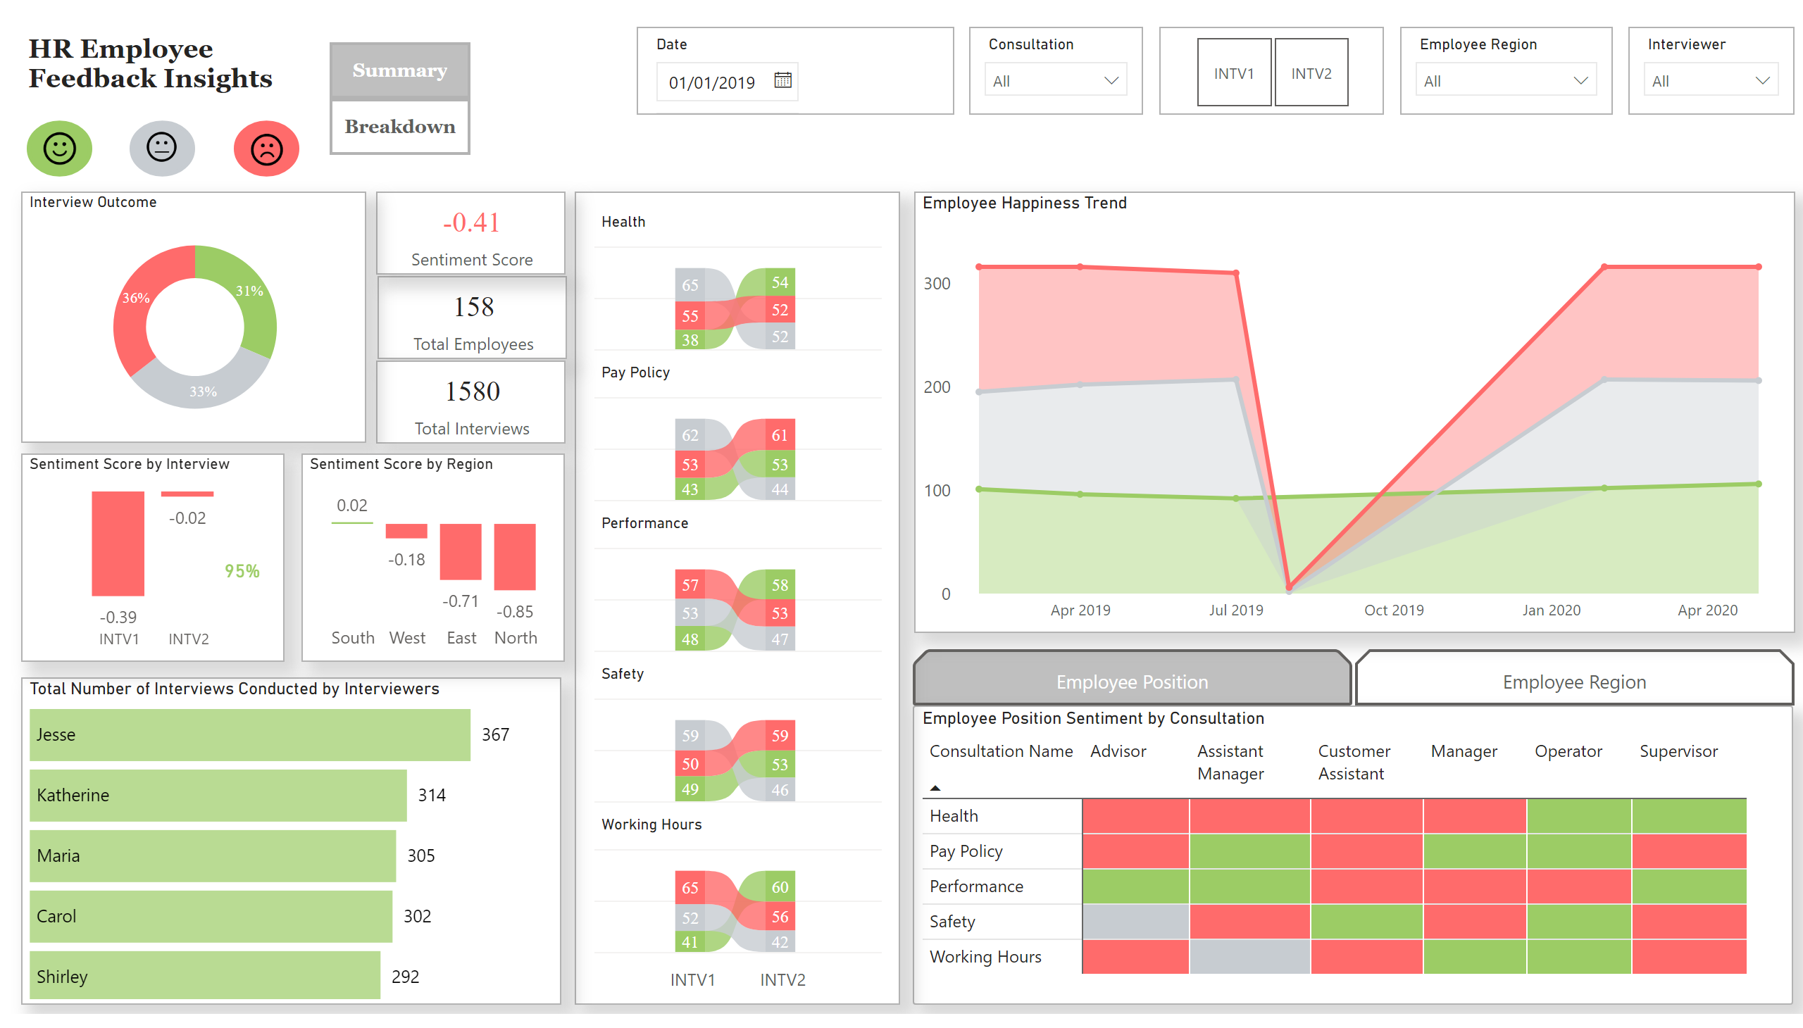
Summary Insights
Notes:
Employee Position Sentiment by Consultation
No alt text provided
pivotTable
No alt text provided
actionButton
No alt text provided
ER Button
No alt text provided
EP Button
No alt text provided
actionButton
No alt text provided
Total Number of Interviews Conducted by Interviewers
No alt text provided
card
No alt text provided
card
No alt text provided
card
No alt text provided
slicer
No alt text provided
slicer
No alt text provided
slicer
No alt text provided
slicer
No alt text provided
slicer
No alt text provided
textbox
No alt text provided
image
No alt text provided
basicShape
No alt text provided
image
No alt text provided
basicShape
No alt text provided
image
No alt text provided
basicShape
No alt text provided
Interview Outcome
No alt text provided
card
No alt text provided
Sentiment Score by Interview
No alt text provided
ribbonChart
No alt text provided
Employee Happiness Trend
No alt text provided
Sentiment Score by Region
No alt text provided
actionButton
No alt text provided
actionButton
No alt text provided

Slide 3
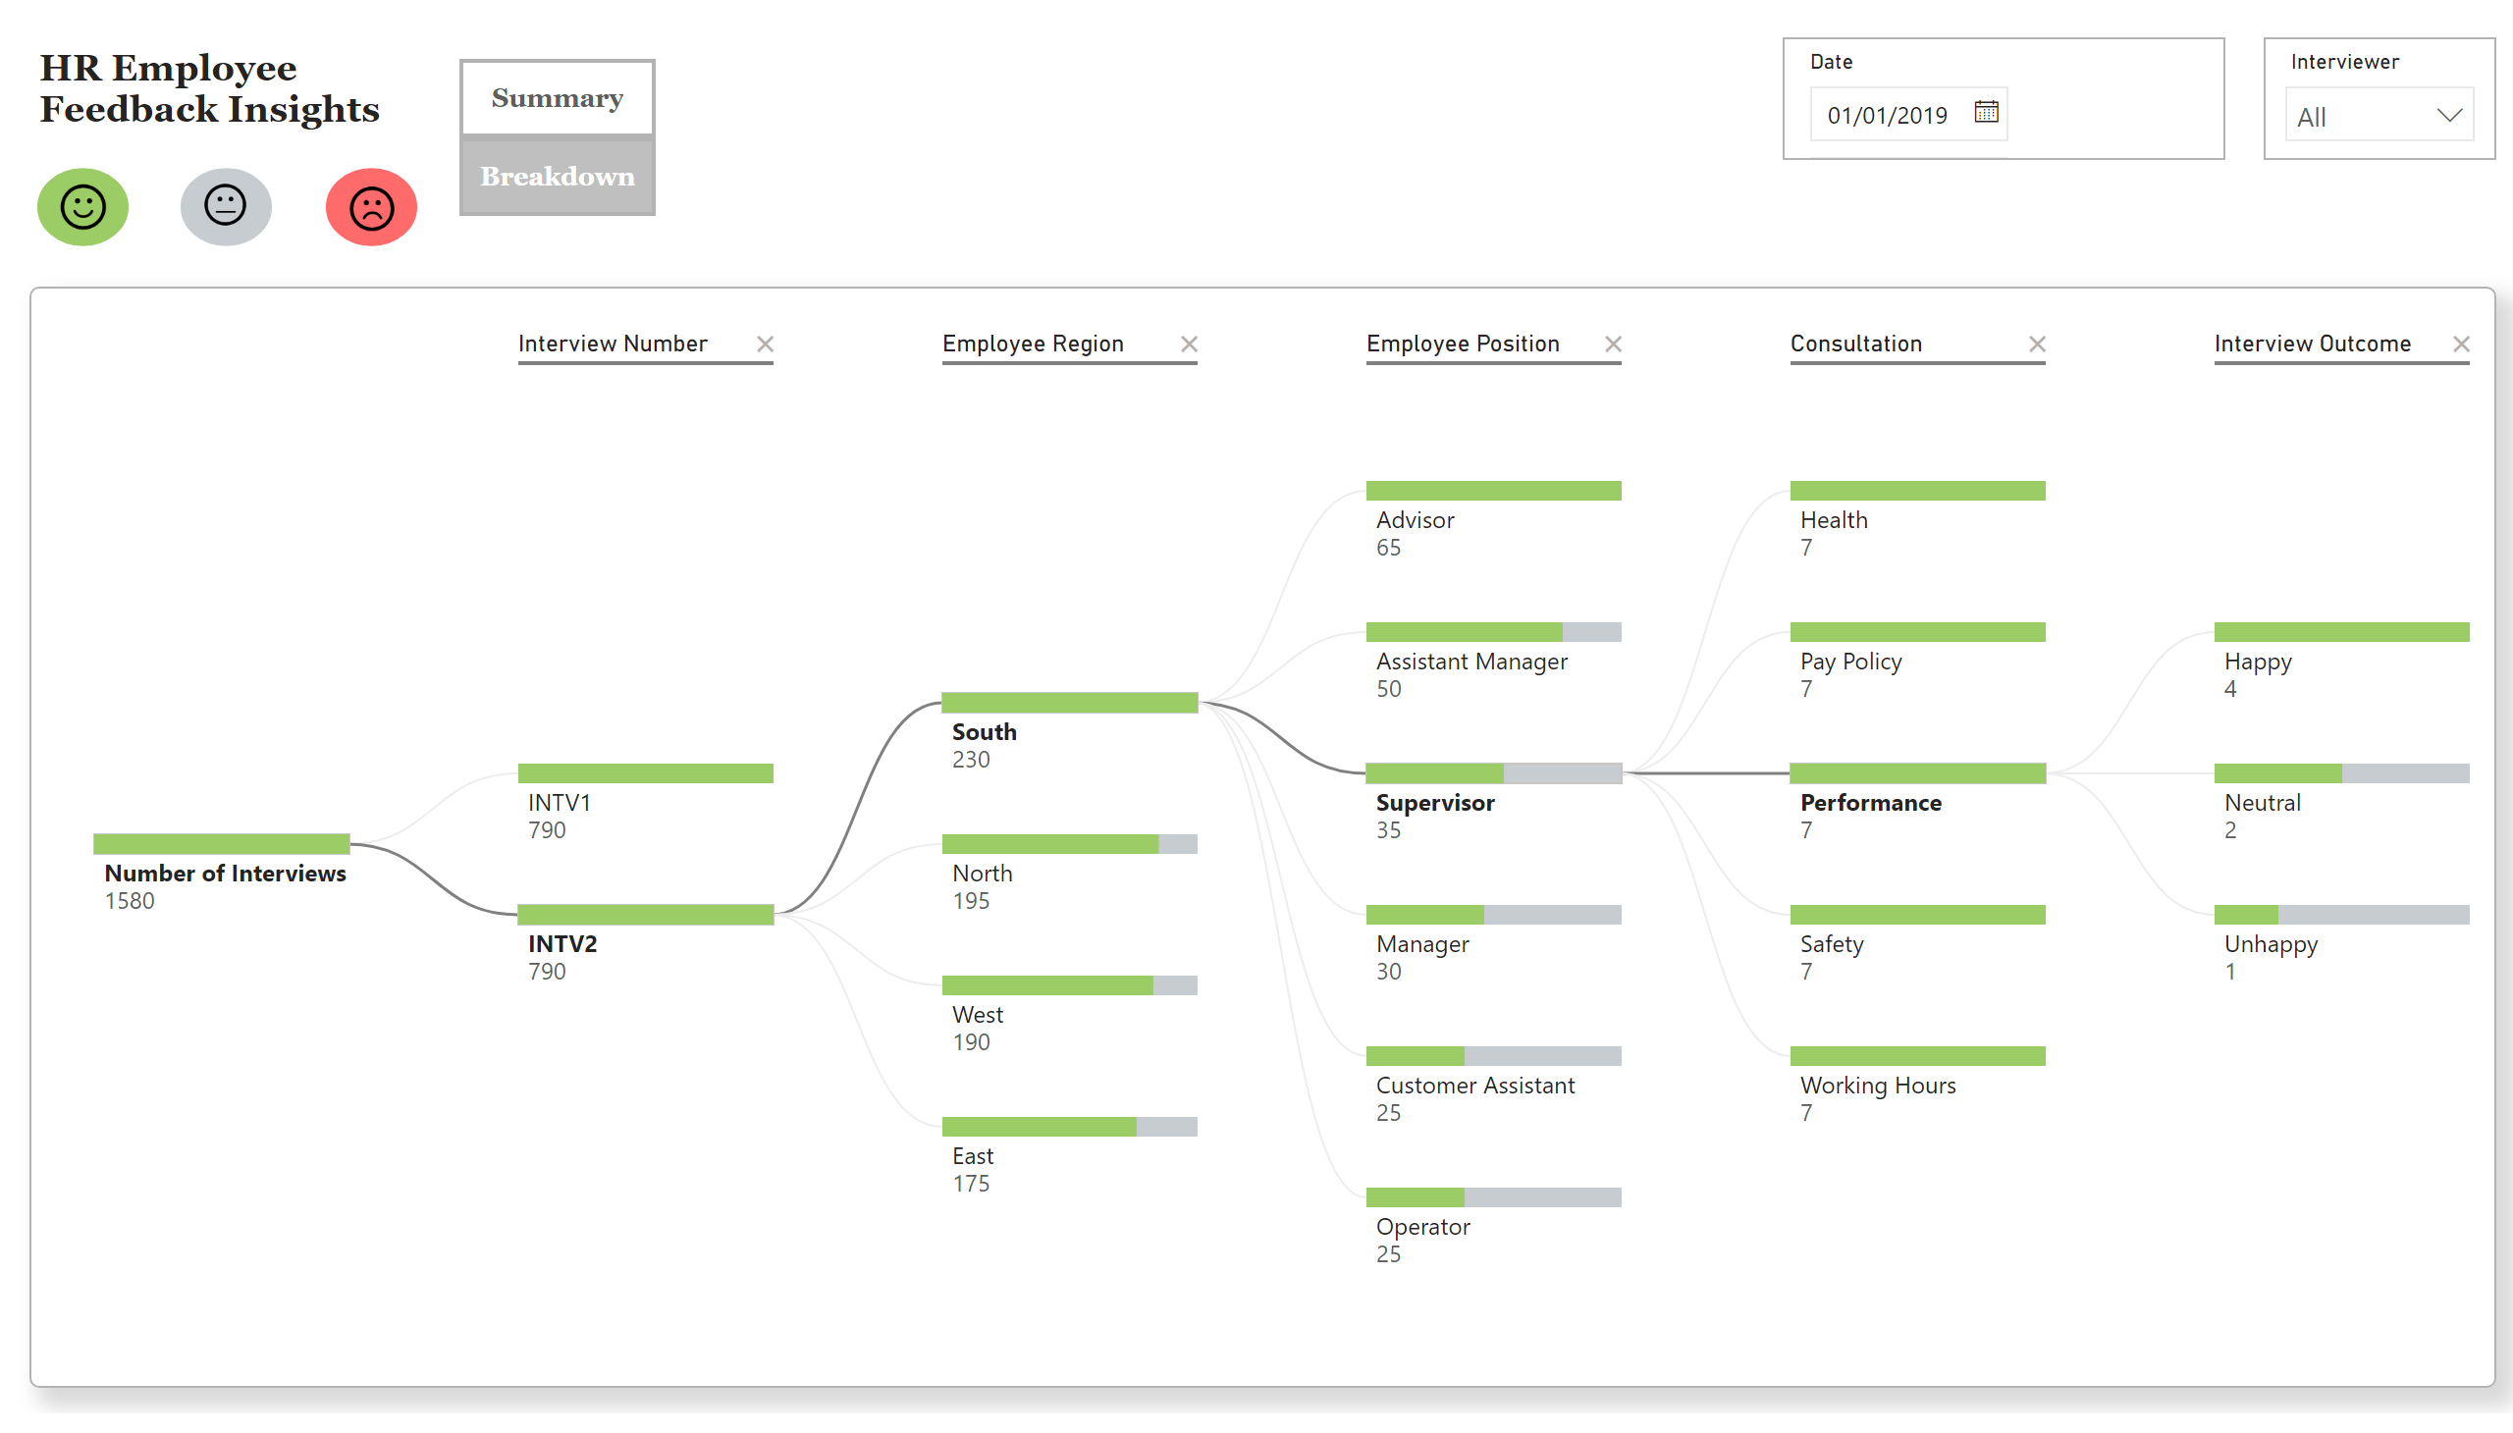
Decomposition Tree
Notes:
decompositionTreeVisual
No alt text provided
textbox
No alt text provided
image
No alt text provided
basicShape
No alt text provided
image
No alt text provided
basicShape
No alt text provided
image
No alt text provided
basicShape
No alt text provided
slicer
No alt text provided
slicer
No alt text provided
actionButton
No alt text provided
actionButton
No alt text provided

